Slide 1
Utah Division of Water Rights
Advanced Water Right Topics
Rural Water Training—April 2018
Chase McDonald
June 21, 2004

Slide 2
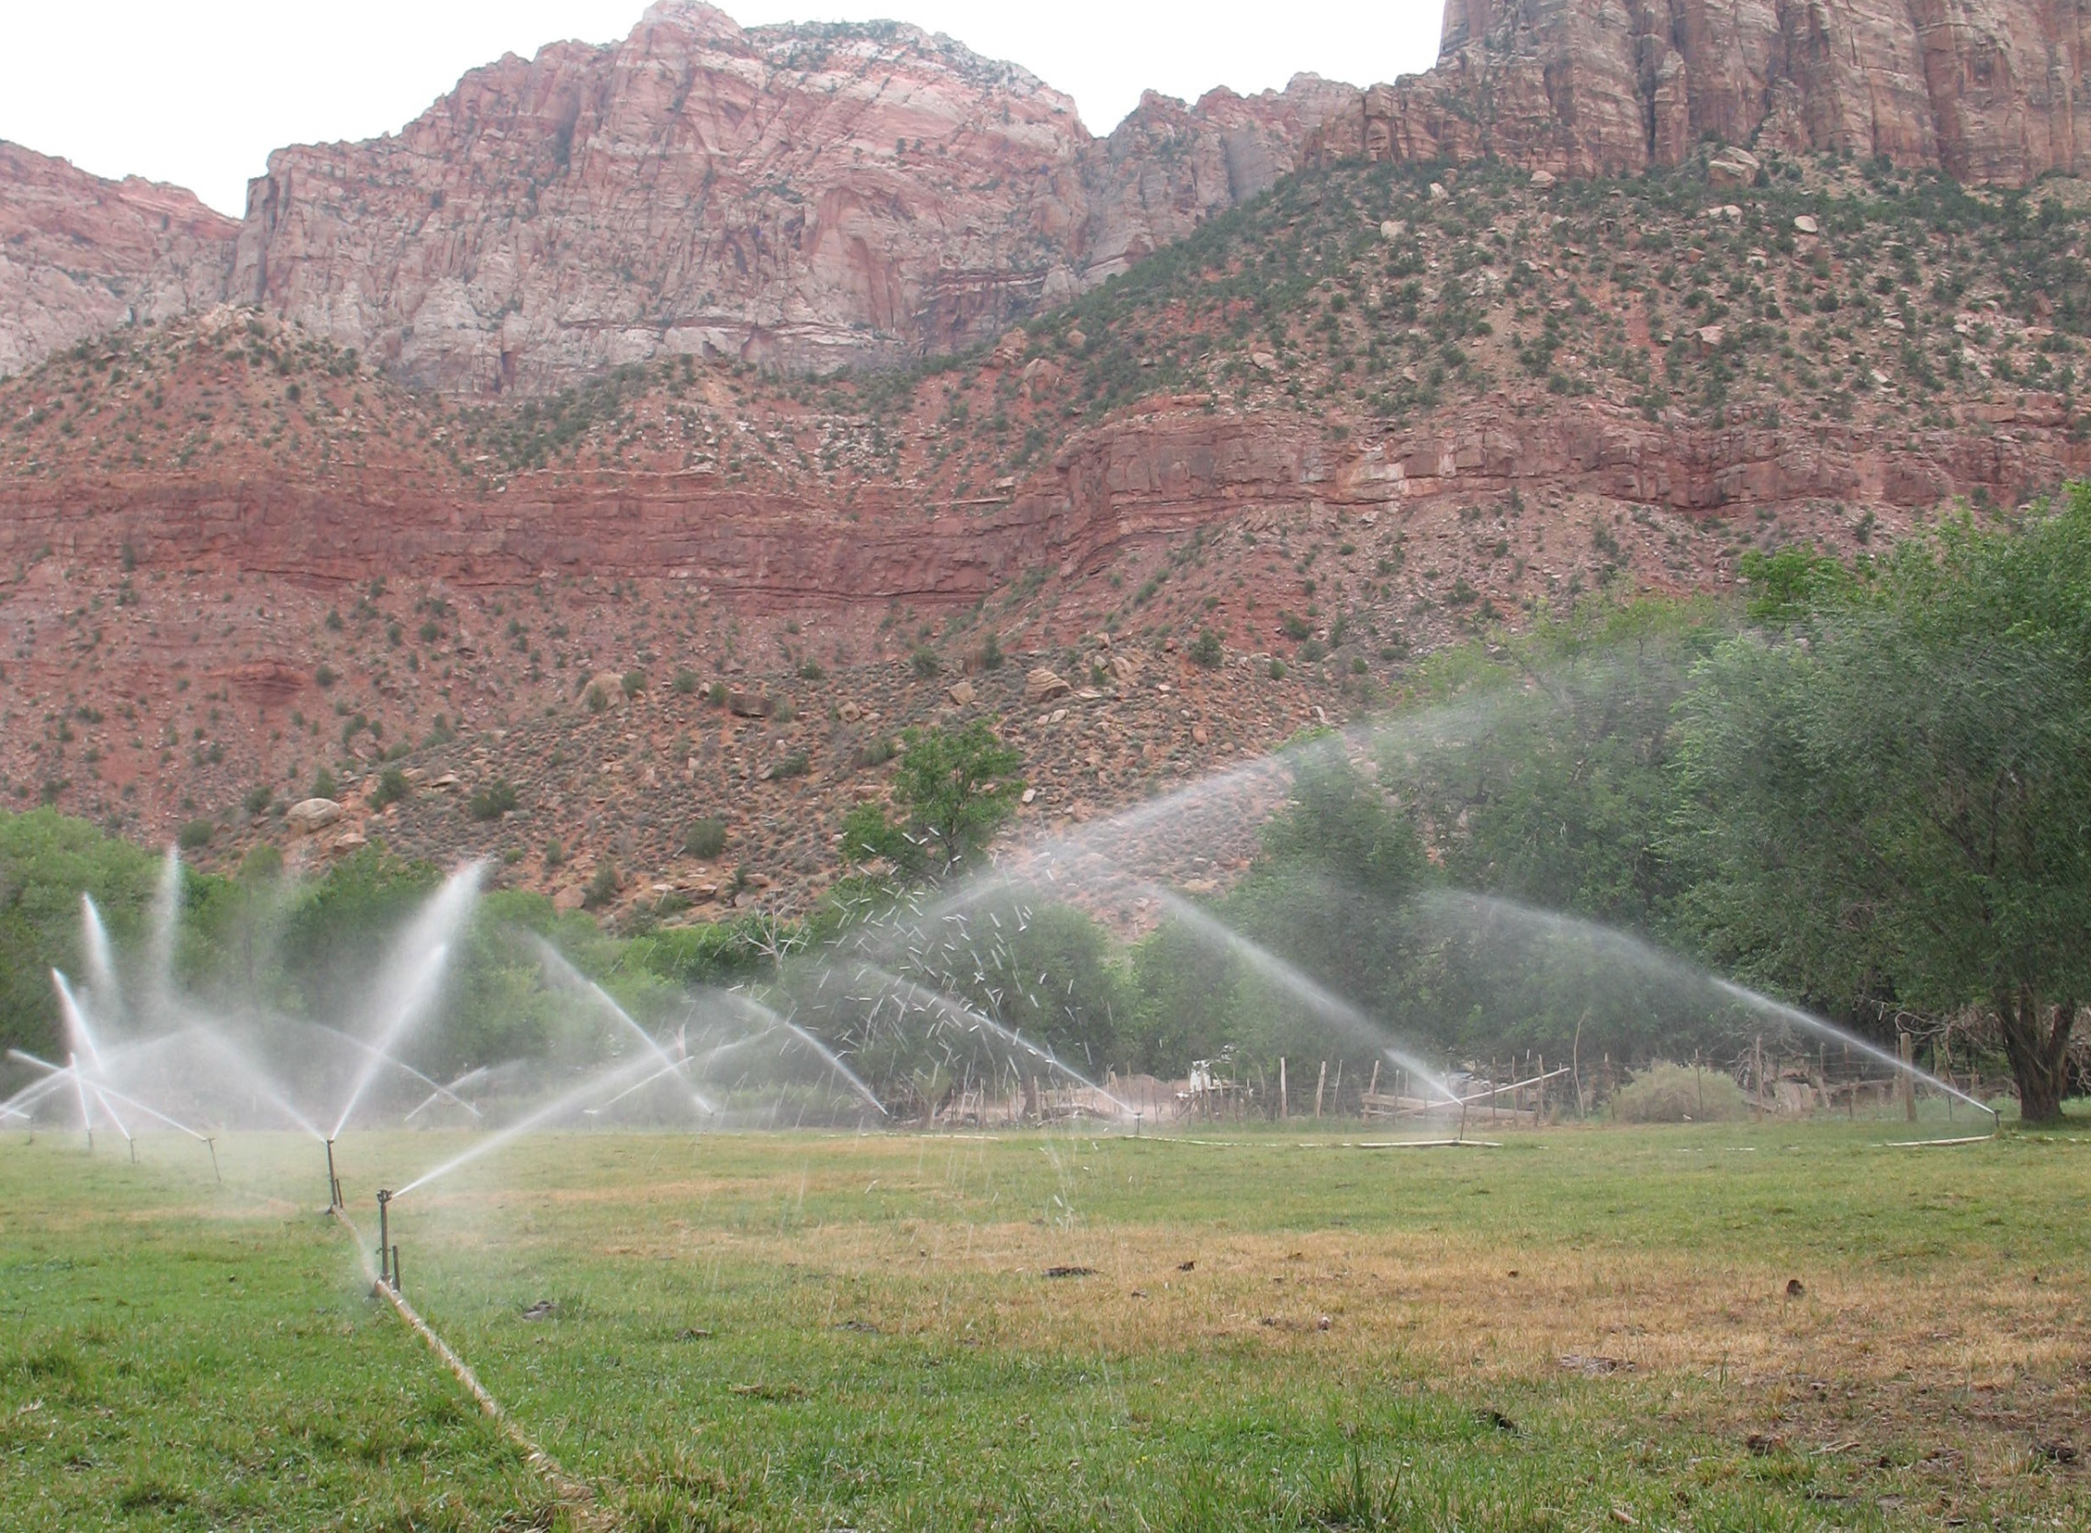
Shares vs. Rights
Is there a difference?

Slide 3
Share vs. Water Right
Water Right
Property right created within Title 73 of the Utah Code.
Entitles water right owner to divert and beneficially use water within the limits of the water right.
Appurtenant to land if there is a unity of title
Ownership transfers with the land unless severed.
County recorder is the office of record of ownership for perfected water rights
Notes:
Application to Appropriate
Decree
Diligence or Underground Water Claim
Reserved Right.

Slide 4
Share vs. Water Right
Share in water company
Equal interests into which the entire stock of a water company is divided
Entitles the shareholder to a proportionate share of water in the water company within the limits of the company’s water right.
Not appurtenant to land
Ownership transfers by company reissuing share certificate in new owners name.
Company keeps records of ownership
Notes:
Application to Appropriate
Decree
Diligence or Underground Water Claim
Reserved Right.

Slide 5
Change Application by Shareholder Applicant’s Responsibilities, UC 73-3-3.5
Change Applications on Shares of Stock
UC 73-3-3.5
Prepare a proposed change application
Deliver the proposed change application to the water company
Cooperate with company in preparation and/or correction of application
Applicant (shareholder) responsibilities:
Notes:
Delivery of the application to the company must be by personal delivery with a signed receipt, certified mail, or electronic mail with confirmation of receipt.

Slide 6
Change Application by Shareholder Applicant’s Responsibilities, UC 73-3-3.5
Change Applications on Shares of Stock
UC 73-3-3.5
Proposed change application shall include:
the certificate number of the stock affected by the change;
a description of the land proposed to be retired from irrigation (if applicable);
an agreement by the shareholder to continue to pay all applicable corporate assessments on the share affected by the change; and
any other information that the water company may reasonably need to evaluate the proposed change application.
Applicant (shareholder) responsibilities:
Notes:
HTF map is appreciated in the case that the change application involves a situation where water was previously used for irrigation.

Slide 7
Change Application by Shareholder Company’s Responsibilities UC 73-3-3.5
Change Applications on Shares of Stock cont.
Company responsibilities:
Respond within 120 days in writing.
Consent
Consent subject to conditions
Decline consent, describe reasons
No response by the company within 120 days is deemed consent.

Slide 8
Change Application by Shareholder Company’s Responsibilities UC 73-3-3.5
Change Applications on Shares of Stock cont.
Company responsibilities:
Company may consider:
Increase in cost
Interference with ability to manage and distribute water
More water than shareholder’s proportionate share
Preferential access to the detriment of others
Impair quantity or quality of water, including carrier water
(continued)

Slide 9
Change Application by Shareholder Company’s Responsibilities UC 73-3-3.5
Change Applications on Shares of Stock cont.
Company responsibilities:
Company may consider:
Violation of statute, ordinance, regulation, or order of a court or government agency
Can retirement of beneficial use be accomplished as proposed? (if applicable)
Cumulative effects
May not withhold consent if issue can be reasonably mitigated without cost to company
May require shareholder to pay costs (within reason)

Slide 10
Change Application by Shareholder Applicant’s Responsibilities, UC 73-3-3.5
Change Applications on Shares of Stock
UC 73-3-3.5
File change application
Change application must include shareholder’s authority to file:
Water company's response to the shareholder's proposed change application, or
Affidavit signed by the shareholder documenting the water company's failure to respond, or
Court order
After approval, shareholder may submit extensions of time without company involvement
Applicant (shareholder) responsibilities:

Slide 11
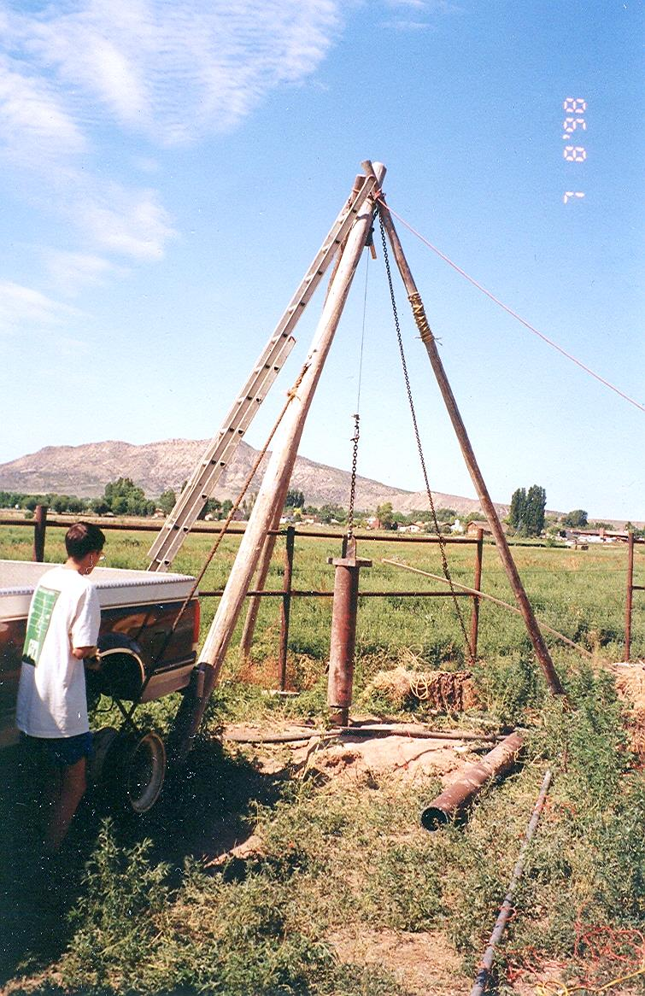
When an individual wants to file a change application based on shares of stock in an irrigation company – what must he do?
When an irrigation company receives a request to file a change from a shareholder what should it do?
An irrigation company could incur liability by…???
Is a share the same as a water right?

Slide 12
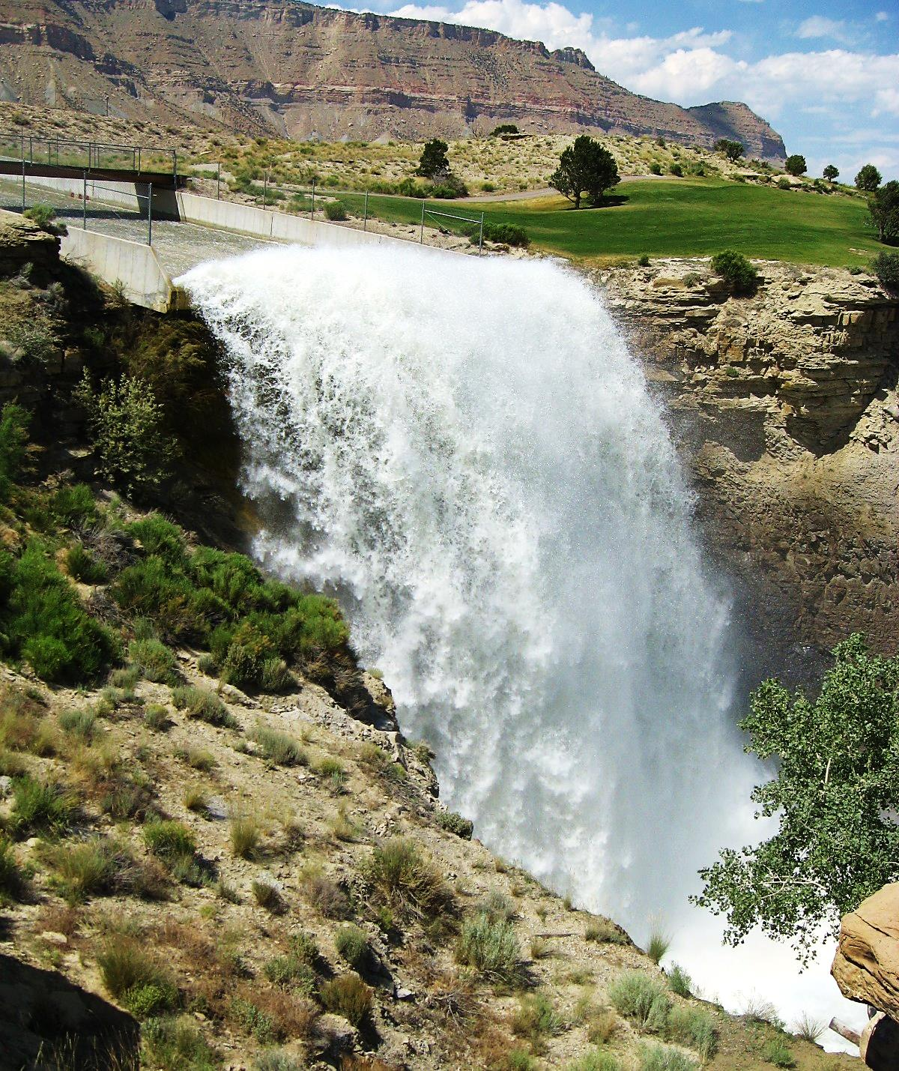
Questions? Comments?
Humorous Anecdotes?

